Slide 1
Double-Ended Queues
데크

Slide 2
Topics
Double-Ended Queues (a.k.a. Deque) ADT
STL Deque
Implementing a Deque with a Doubly Linked List
Adapters and the Adapter Design Pattern

Slide 3
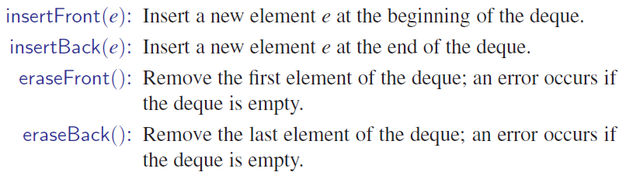
The Deque ADT
A Queue-like data structure
Supports insertion and deletion at both ends (front/rear of the queues)
Main methods

Slide 4
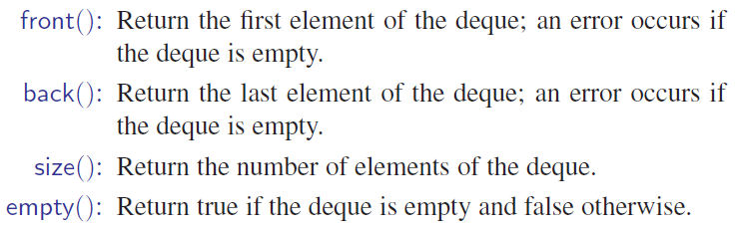
The Deque ADT (con’t)
Auxiliary methods

Slide 5
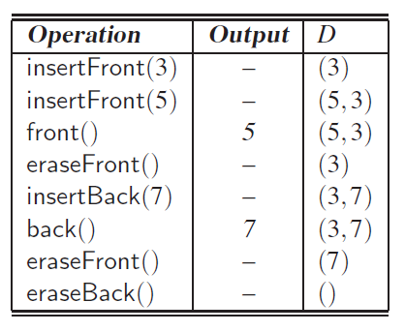
Example of deque operations

Slide 6
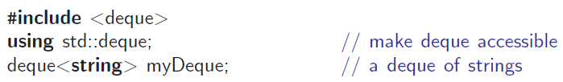
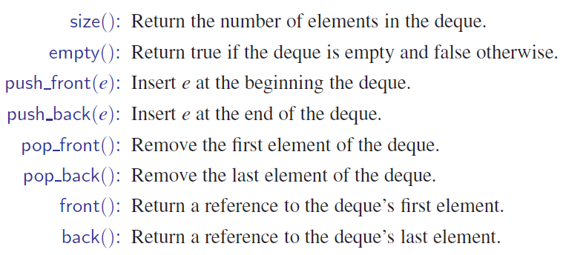
The STL Deque
size()
empty()
insertFront(e)
insertBack(e)
eraseFront()
eraseBack()
front()
back()

Slide 7
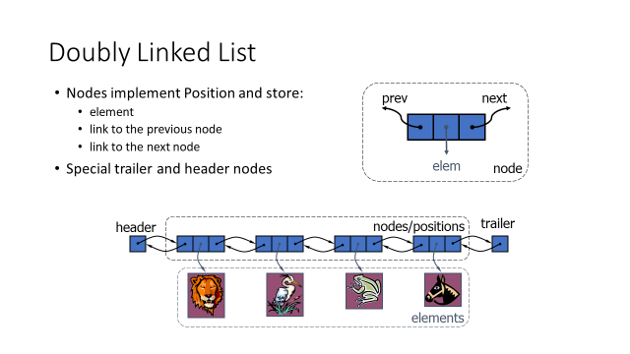
Doubly Linked List based Deque – Linked Deque
front of a deque
rear of a deque

Slide 8
LinkedDeque
typedef string Elem; // deque element type
class LinkedDeque { // deque as doubly linked list
public:
LinkedDeque(); // constructor
int size() const; // number of items in the deque
bool empty() const; // is the deque empty?
const Elem& front() const throw(DequeEmpty); // the first element
const Elem& back() const throw(DequeEmpty); // the last element
void insertFront(const Elem& e); // insert new first element
void insertBack(const Elem& e); // insert new last element
void removeFront() throw(DequeEmpty); // remove first element
void removeBack() throw(DequeEmpty); // remove last element
private: // member data
DLinkedList D; // linked list of elements
int n; // number of elements
};

Slide 9
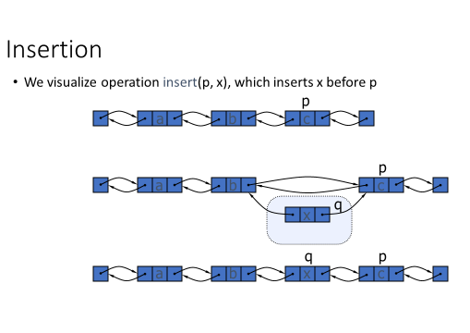
Insertion
add(p,x) of DLinkedList
// insert new first element
void LinkedDeque::insertFront(const Elem& e) {
D.addFront(e);
n++;
}
// insert new last element
void LinkedDeque::insertBack(const Elem& e) {
D.addBack(e);
n++;
}
void DLinkedList::addFront(const Elem& e)
{ add(header->next, e); }
void DLinkedList::addBack(const Elem& e)
{ add(trailer, e); }

Slide 10
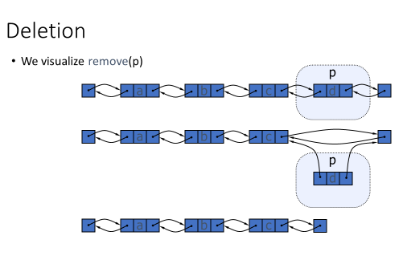
Deletion
// remove first element
void LinkedDeque::removeFront() throw(DequeEmpty) {
if (empty())
throw DequeEmpty("removeFront of empty deque");
D.removeFront();
n--;
}
// remove last element
void LinkedDeque::removeBack() throw(DequeEmpty) {
if (empty())
throw DequeEmpty("removeBack of empty deque");
D.removeBack();
n--;
}
void DLinkedList::removeFront() { remove(header->next); }
void DLinkedList::removeBack()
{ remove(trailer->prev); }

Slide 11
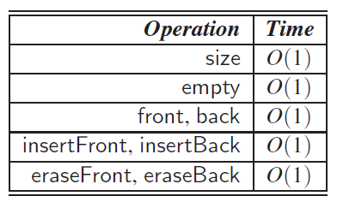
Time complexity of each method of the LinkedDeque

Slide 12
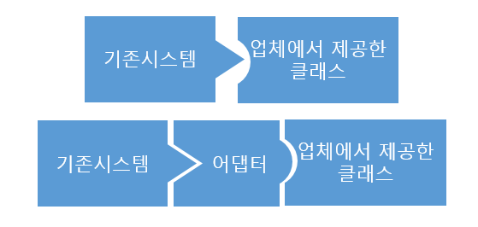
Adapters
Adapters translate one interface to another.
e.g., in LinkedDeque, we simply mapped operations of LinkedDeque to corresponding opertations of DLinkedList
(e.g., insertFront →addFront)

Slide 13
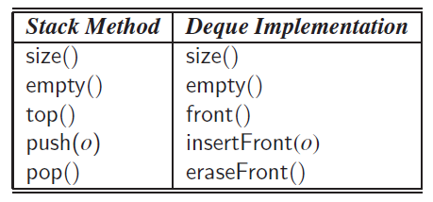
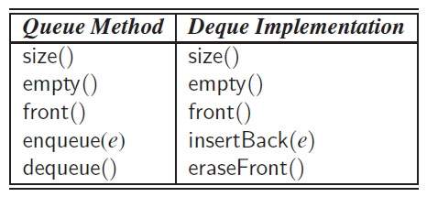
Adapter based implementations
Deque methods
size()
empty()
insertFront(e)
insertBack(e)
eraseFront()
eraseBack()
front()
back()
LIFO
FIFO

